Slide 1
ITP171 it fundamentals
AND PROJECT
Enterprise Computing

Slide 2
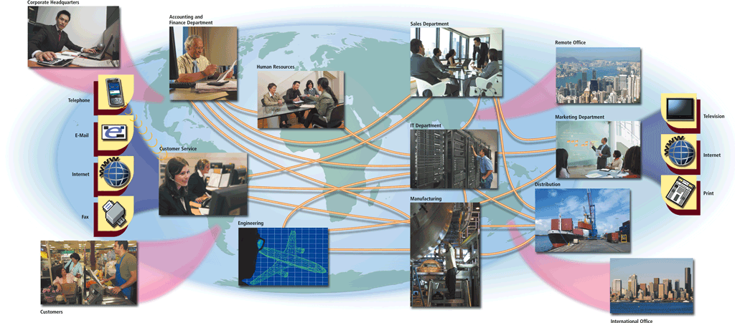
What Is Enterprise Computing?
Enterprise computing involves the use of computers in networks, such as LANs and WANs, or a series of interconnected networks that encompass a variety of different operating systems, protocols, and network architectures

Slide 3
What Is Enterprise Computing?
Types of enterprises include:
Retail
Manufacturing
Service
Wholesale
Government
Educational
Transportation

Slide 4

ERP – Enterprise Resource Planning

Slide 5
Virtualization
Virtualization is the practice of sharing or pooling computing resources
Server virtualization
Provides the capability to divide a physical server logically into many virtual servers
Storage virtualization
Provides the capability to create a single logical storage device from many physical storage devices

Slide 6
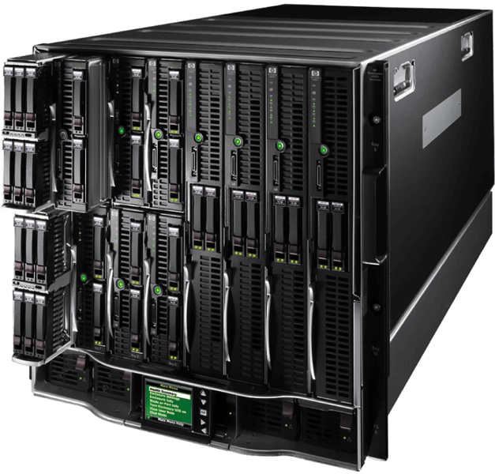
Enterprise Hardware
A blade server packs a complete computer server on a single card (called a blade) rather than a system unit
The individual blades insert in a blade server chassis

Slide 7
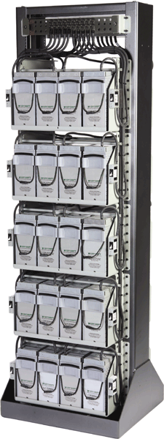
High Availability, Scalability, and Interoperability
A high-availability system continues running and performing tasks for at least 99 percent of the time
  May include hot-swapping
  and redundant components
    When a component fails, another
    component takes over and the
    system continues to function

Slide 8
High Availability, Scalability, and Interoperability
Scalability is a measure of how well computer hardware, software, or an information system can grow to meet increasing performance demands
Interoperability is the ability for an information system to share information with other information systems within an enterprise

Slide 9
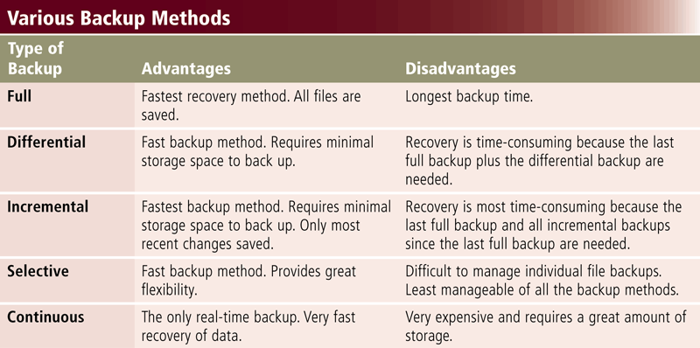
Backup Procedures

Slide 10
Backup Procedures
A disaster recovery plan is a written plan describing the steps a company would take to restore computer operations in the event of a disaster
Contains four major components
Emergency plan
Backup plan
Recovery plan
Test plan

Slide 11
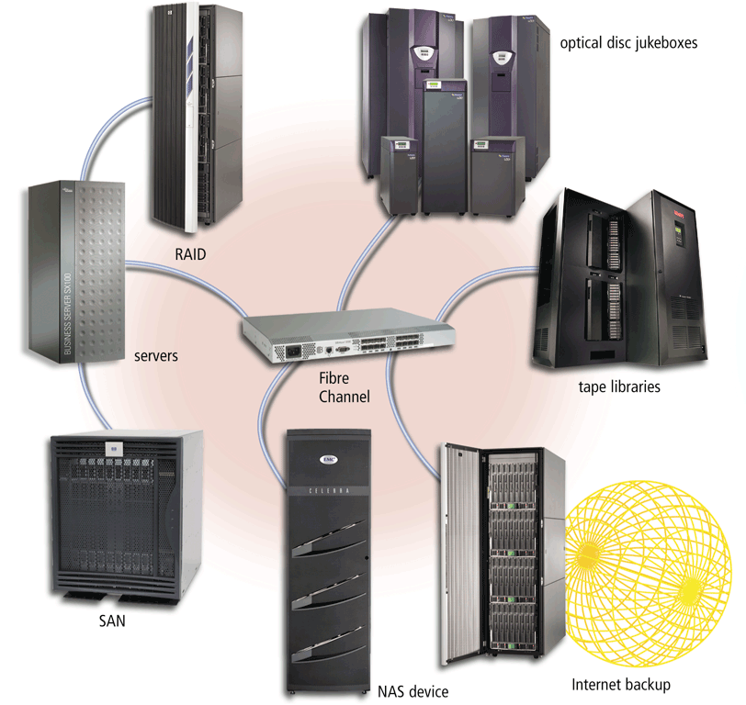
Enterprise Storage
An enterprise storage system is a strategy that focuses on the availability, protection, organization, and backup of storage in a company
Goal is to consolidate storage

Slide 12
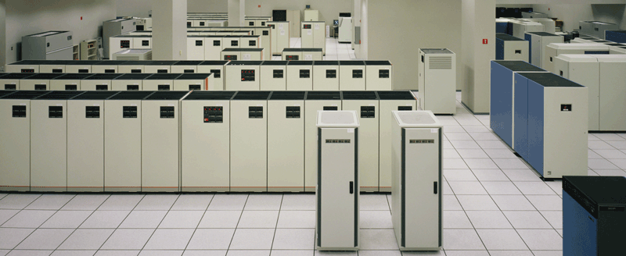
Enterprise Storage
Enterprise storage stores huge volumes of data and information for large businesses
  Uses special hardware for heavy use, maximum availability, and maximum efficiency
Page 379
Figure 7-39

Slide 13
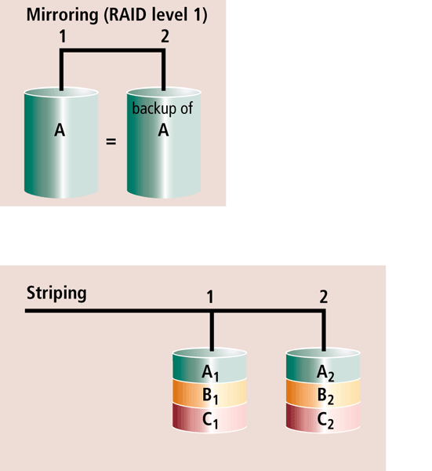
Enterprise Hardware
Enterprise hardware allows large organizations to manage and store information and data using devices geared for:
  Heavy use
  Maximum availability
  Maximum efficiency
RAID duplicates data and
implements duplication
in different ways

Slide 14
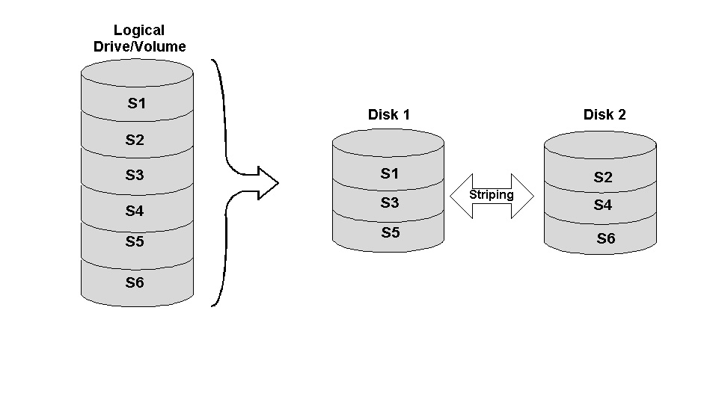
RAID 0 or striping
RAID (originally redundant array of inexpensive disks, now commonly redundant array of independent disks)
Data are split onto different disks for performance increase: performances depend on information unit size vs stripe size
No redundancy added
Cost is limited (no additional hardware)

Slide 15
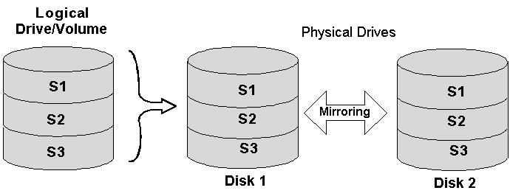
RAID 1 - mirroring
Data are replicated on multiple disks for redundancy
Performance may be impacted if copy is done serially
Increase of cost proportional to the amount of redundancy
More complex algorithm to manage multiple copies

Slide 16
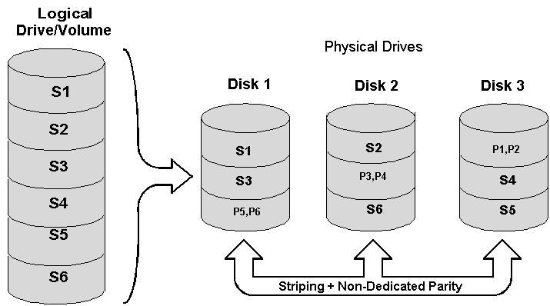
RAID 5
Data protection with ECC, but parity is spread on the array
Good redundancy
Same speed reads, slower writes
One disk per array of added cost

Slide 17
What is RAID 0,1,5 &10?

Slide 18
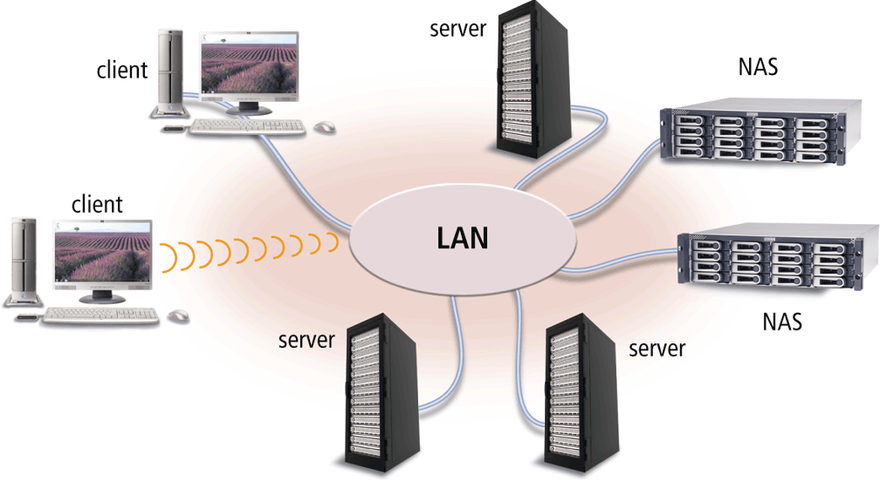
Enterprise Hardware
Network attached storage (NAS) is a server that provides storage to users and information systems attached to the network
Page 749
Figure 14-28a

Slide 19
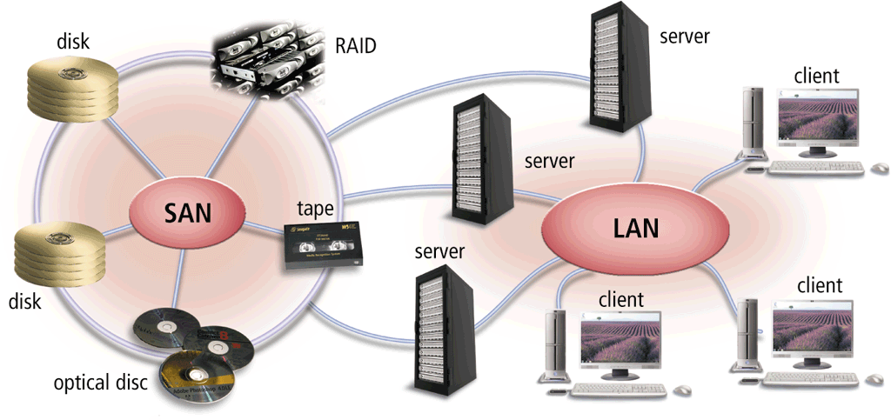
Enterprise Hardware
A storage area network (SAN) is a high-speed network that provides storage to other servers to which it is attached
Page 749
Figure 14-28b

Slide 20
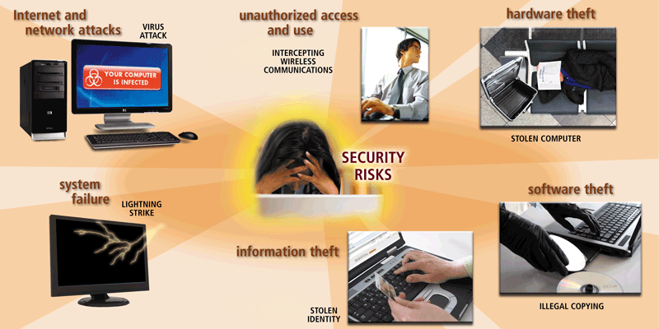
Computer Security Risks

Slide 21
Steps of an Attack
The five steps that make up an attack
  Probe for information
  Penetrate any defenses
  Modify security settings
  Circulate to other systems
  Paralyze networks and devices
Notes:
Extra Reference
http://5steps2hack.blogspot.com/2008/07/learn-hacking-in-5-easy-steps.html

Slide 22
Types of Attacks
Attacks can result in one of a few general consequences:
  A loss of confidentiality where information is disclosed to unauthorized individuals.
  A loss of integrity where information is modified by unauthorized individuals.
  A loss of availability where information or the systems processing it are not available for authorized users.

Slide 23
Defenses against Attacks
Layering
  A layered approach can also be useful in resisting a variety of attacks
  Layered security provides the most comprehensive protection
Limiting
  Limiting access to information reduces the threat against it
  Only those who must use data should have access to it
  In addition, the amount of access granted to someone should be limited to what that person needs to know
Diversity
  Layers must be different (diverse)
  If attackers penetrate one layer, they cannot use the same techniques to break through all other layers
  Using diverse layers of defense means that breaching one security layer does not compromise the whole system.

Slide 24
Defenses against Attacks
Obscurity
  An example of obscurity would be not revealing the type of computer, operating system, software, and network connection a computer uses
  An attacker who knows that information can more easily determine the weaknesses of the system to attack it
  Obscuring information can be an important way to protect information
Simplicity
  As much as possible, a secure system should be simple for those on the inside to understand and use
  Complex security schemes are often compromised to make them easier for trusted users to work with
  Keeping a system simple from the inside but complex on the outside can sometimes be difficult but reaps a major benefit

Slide 25
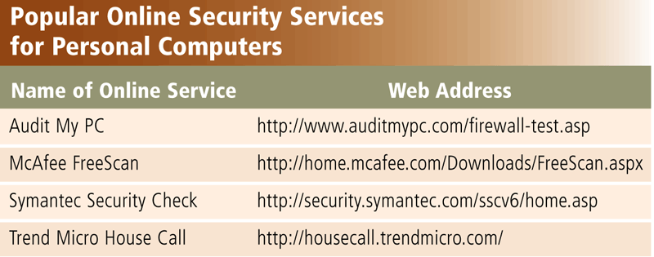
Internet and Network Attacks
Information transmitted over networks has a higher degree of security risk than information kept on an organization’s premises
An online security service is a Web site that evaluates your computer to check for Internet and e-mail vulnerabilities

Slide 26
Internet and Network Attacks
Computer Virus
Affects a computer negatively by altering the way the computer works
Worm
Copies itself repeatedly, using up resources and possibly shutting down the computer or network
Trojan Horse
A malicious program that hides within or looks like a legitimate program
Rootkit
Program that hides in a computer and allows someone from a remote location to take full control

Slide 27
Internet and Network Attacks
An infected computer has one or more of the following symptoms:
Operating system runs much slower than usual
Available memory is less than expected
Files become corrupted
Screen displays unusual message or image
Music or unusual sound plays randomly
Existing programs and files disappear
Programs or files do not work properly
Unknown programs or files mysteriously appear
System properties change
Operating system does not start up
Operating system shuts down unexpectedly

Slide 28
Video: Attack of the Mobile Viruses

Slide 29
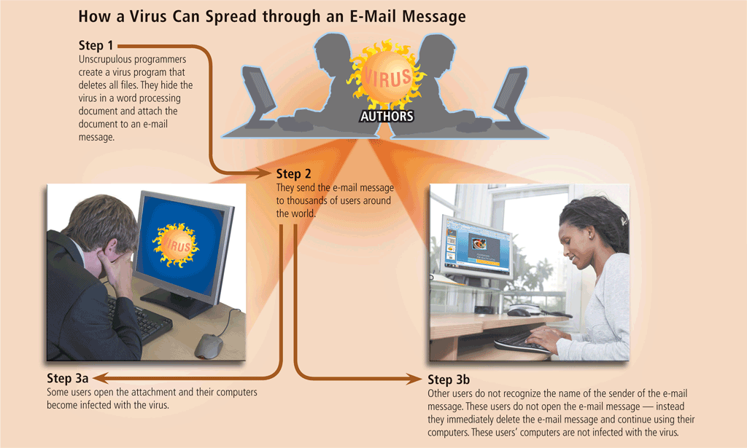
Internet and Network Attacks

Slide 30
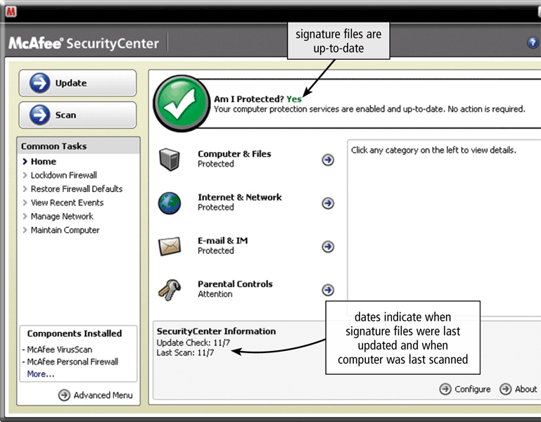
Internet and Network Attacks

Slide 31
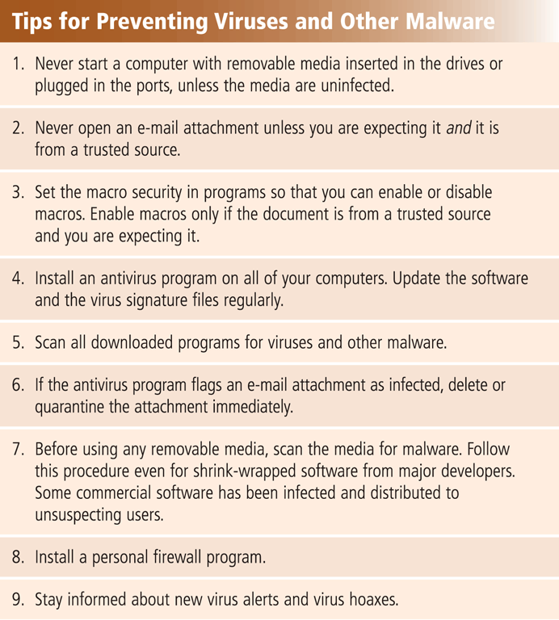
Internet and Network Attacks
Users can take several precautions to protect their home and work computers and mobile devices from these malicious infections

Slide 32
Internet and Network Attacks
A botnet is a group of compromised computers connected to a network
  A compromised computer is known as a zombie
A denial of service attack (DoS attack) disrupts computer access to Internet services
  Distributed DoS (DDoS)
A back door is a program or set of instructions in a program that allow users to bypass security controls
Spoofing is a technique intruders use to make their network or Internet transmission appear legitimate

Slide 33
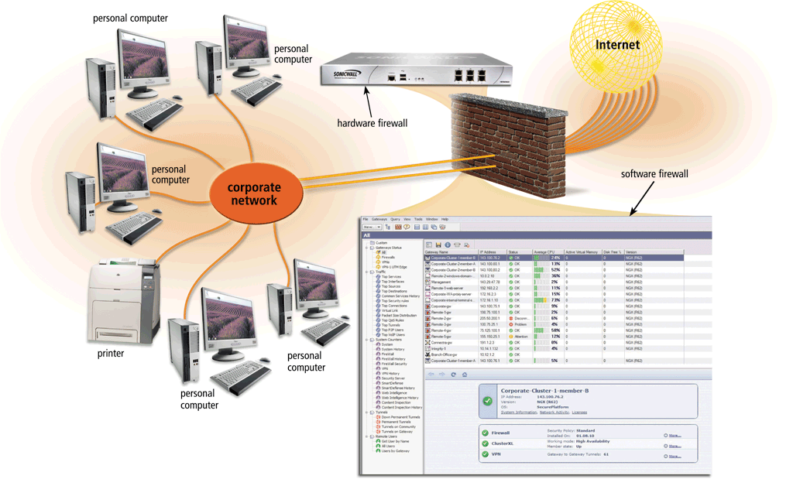
Internet and Network Attacks
A firewall is hardware and/or software that protects a network’s resources from intrusion

Slide 34
Internet and Network Attacks
Intrusion detection software
Analyzes all network traffic
Assesses system vulnerabilities
Identifies any unauthorized intrusions
Notifies network administrators of suspicious behavior patterns or system breaches
Honeypot
Vulnerable computer that is set up to entice an intruder to break into it

Slide 35
News about Cyber Security Attacks
Cyber attacks in Singapore
http://www.straitstimes.com/singapore/take-steps-to-secure-online-accounts-experts-urge
Advice:
If you are using your NRIC and telephone numbers or birth date as a password to secure online accounts, change it immediately.

